Slide 1
UB Faculty Senate Social Media
By Caroline Lojacono
Student Assistant in the Office of Shared Governance
Sophomore, Biomedical Sciences
@UBFacultySenate
#SharedGovernance

Slide 2
What is Online Social Networking?
Use of social media for communication and education
Web-based applications that allow for exchange of information and ideas
Powerful/efficient/inexpensive tool for communication and education
@UBFacultySenate
#SharedGovernance

Slide 3
Why Online Social Networking?
Information acquisition and exchange
Creation of web content
Creation/maintenance of professional relationships
@UBFacultySenate
#SharedGovernance

Slide 4
Why should I follow the Faculty Senate on social media?
@UBFacultySenate
#SharedGovernance

Slide 5
1.
You will receive timely and relevant information about upcoming meetings and events
@UBFacultySenate
#SharedGovernance

Slide 6
2. You can read stories featuring UB faculty, research, and projects, as well as news about the SUNY system and articles from the UB Spectrum Examples of UB twitter accounts you could receive news from: @UBuffalo @UBSpectrum @SUNY
@UBFacultySenate
#SharedGovernance

Slide 7
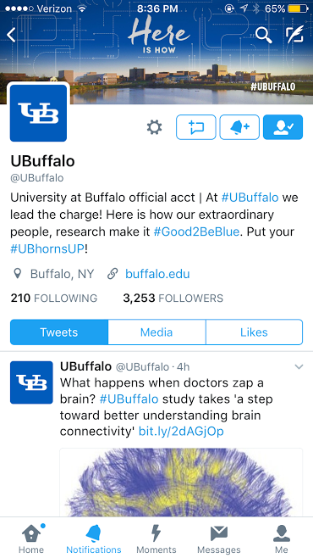
@UBuffalo
@UBFacultySenate
#SharedGovernance

Slide 8
@UBSpectrum
@UBFacultySenate
#SharedGovernance

Slide 9
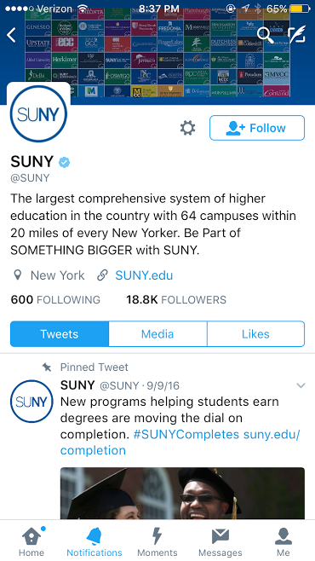
@SUNY
@UBFacultySenate
#SharedGovernance

Slide 10
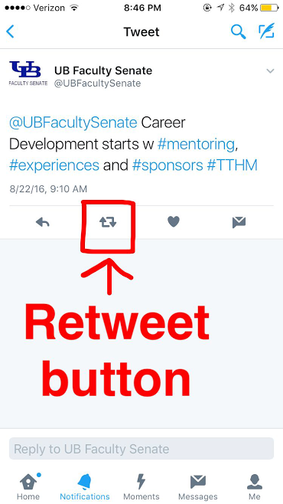
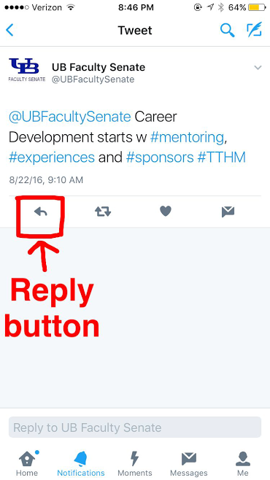
3. You will have the opportunity to: • provide feedback • voice your opinion • support our posts!
@UBFacultySenate
#SharedGovernance

Slide 11
To engage with us on Twitter: 1. Log onto www.twitter.com or download the Twitter app on your phone 2. Click “Sign up” to create an account or “Log in” if you already have an account 3. Once you have an account, search @UBFacultySenate and click “Follow” Now you can retweet and mention us in your posts!
@UBFacultySenate
#SharedGovernance

Slide 12
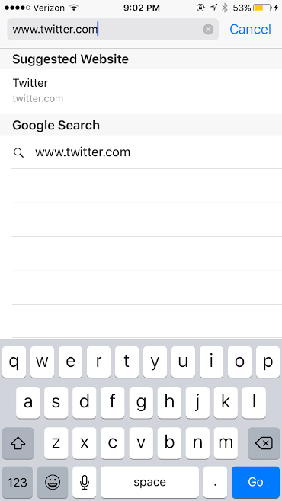
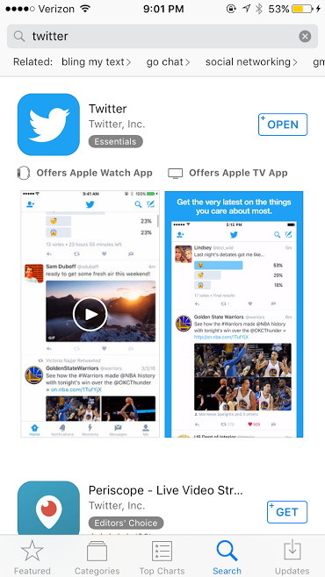
To engage with us on Twitter: 1. Log onto www.twitter.com or download the Twitter app on your phone
@UBFacultySenate
#SharedGovernance

Slide 13
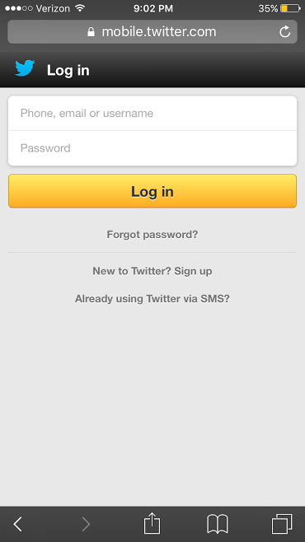
To engage with us on Twitter: 2. Click “Sign up” to create an account or “Log in” if you already have an account
@UBFacultySenate
#SharedGovernance

Slide 14
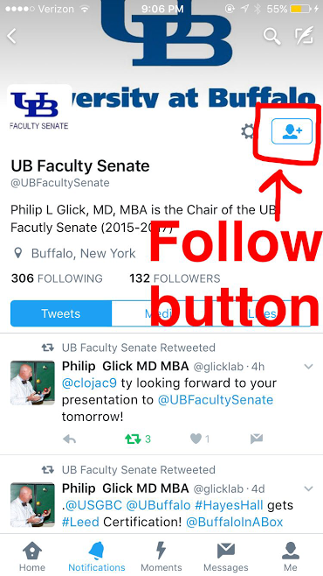
To engage with us on Twitter: 3. Once you have an account, search @UBFacultySenate and click “Follow” Now you can retweet and mention us in your posts!
@UBFacultySenate
#SharedGovernance

Slide 15
#Hashtags
Word/phrase preceded by a hash or pound sign (#) and used to identify messages on a specific topic
Key way that we search for content on social media
Using the right hashtag helps us filter through millions of posts
Helps to group conversations together so it is easier to find things that are relevant to us
@UBFacultySenate
#SharedGovernance

Slide 16
What are some important UB Faculty Senate hashtags?
Hashtag | Description
#UBuffalo | Official UB hashtag to engage other official UB accounts
#SharedGovernance | Use to group Shared Governance events involving the UB Faculty Senate and Professional Staff Senate
#TTHM | “The Take Home Message” “Pearls” of wisdom from speakers. Four things that you can remember a month from now.
 | Any other key words in your tweets!
@UBFacultySenate
#SharedGovernance

Slide 17
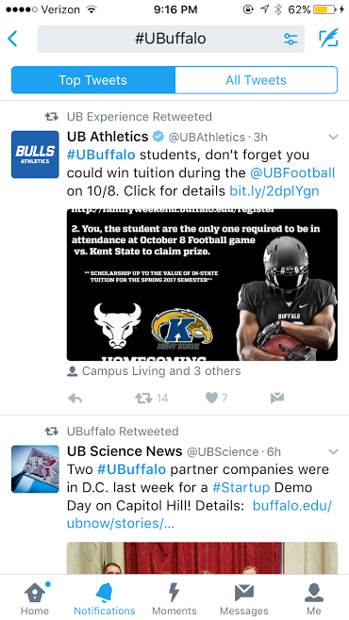
#UBuffalo
@UBFacultySenate
#SharedGovernance

Slide 18
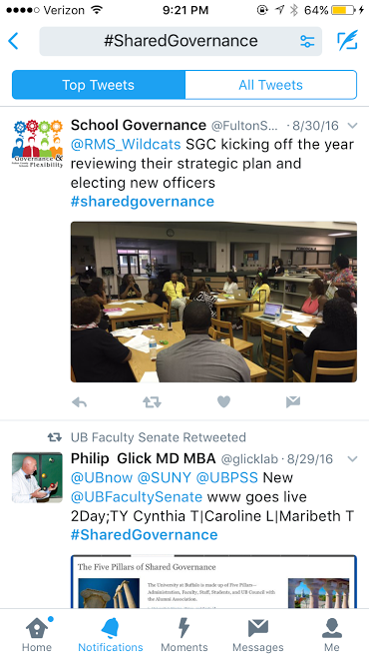
#SharedGovernance
@UBFacultySenate
#SharedGovernance

Slide 19
#TTHM
@UBFacultySenate
#SharedGovernance

Slide 20
Coming Soon: We are creating a UB Faculty Senate Facebook page!
@UBFacultySenate
#SharedGovernance

Slide 21
#TTHM 1 of this presentation
@UBFacultySenate
#SharedGovernance

Slide 22
#TTHM 2 of this presentation
@UBFacultySenate
#SharedGovernance

Slide 23
#TTHM 3 of this presentation
@UBFacultySenate
#SharedGovernance

Slide 24
#TTHM 4 of this presentation
@UBFacultySenate
#SharedGovernance

Slide 25
Thank you! Questions?
@UBFacultySenate
#SharedGovernance

